Slide 1

ELECTRIC VEHICLE ANALYSIS
CAPSTONE PROJECT - 01
PASUPATHI R

Slide 2
Executive Summary
The focus of this project is to build an interactive and insightful dashboard to enhance data-driven decision-making in the electric vehicle (EV) domain.
By Visualizing :
Sales Trends
Total Vehicle by Year
Total Vehicle by Brand
Total Vehicle by State Wise
Total Vehicle by Model
Total Vehicle by clean Alternate Fuel Vehicle.

Slide 3
Overview of Project:
Data
Data Manipulations
Challenges Faced
Outcome of Visualizations
Predictions

Slide 4
Data:
Total size of the Data is 1Mb,with 17 columns with 2 Lakhs Records.
Data Type | Column Names
String | Country, City, State, Model, Make, Ev Type,CAFV.
Integer | Model Year, Vehicle ID,Ev Range
Float | Postal Code, Legislative District,2020 census Track

Slide 5
Data Manipulation:
The Data is obtained from an Online Website Kaggle the link below, Link: https://www.kaggle.com/datasets/sachithprabodha/electric-vehicle-population-data.
The Data was Clean and only problem was unwanted columns which are not required for Dashboards.

Slide 6
Risks and Challenges :
Missing Data :
• Fields like Base MSRP have zero or missing values, which could affect financial and affordability analysis.
Data Inconsistency :
• The column Electric Utility contains multiple entries separated by a delimiter (|). Proper parsing and standardization are required for accurate analysis

Slide 7
Tools and Technologies:
Python:
I use Python for Data cleaning
I removed Vin (1-10), DOL Vehicle ID
Power Bi:
Power BI will be connected to the database to facilitate advanced data analysis. Power BI’s integration with CSV files allows for easy querying and data visualization. This connection enables the transformation of raw data into interactive dashboards, providing comprehensive insights and supporting data-driven decision making processes.

Slide 8
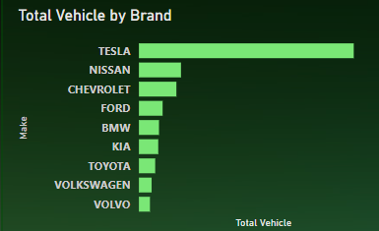
Outcome of Visualization:
Top Brand by Total Vehicle

Slide 9
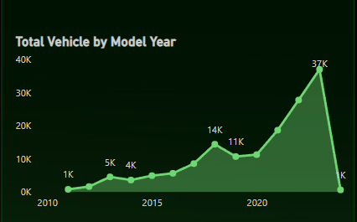
Outcome of Visualization:
Total Vehicle by Year

Slide 10
Predictions:
A logistic regression model was employed to predict the type of electric vehicle (EV).
The model demonstrated a high level of accuracy, achieving a prediction success rate of 89%.
Visualizing Prediction Accuracy.

Slide 11
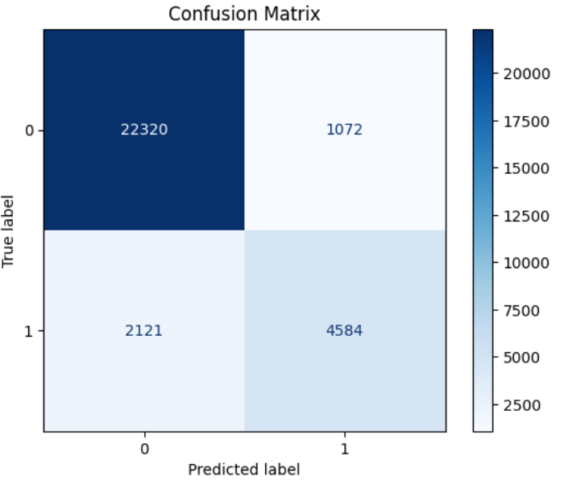
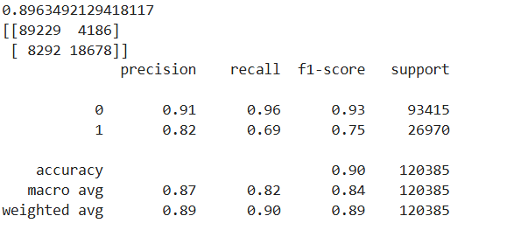
Performance Metrics:
Accuracy

Slide 12
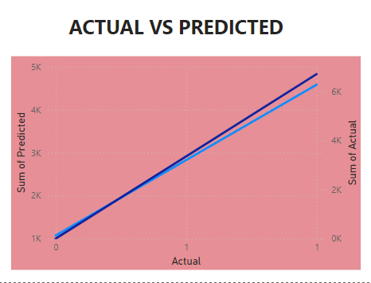

Slide 13
Thank You

